Slide 1

Numpy

Slide 2

Numpy
NumPy is the fundamental package for scientific computing in Python.
It is a Python library that provides a multidimensional array object, various derived objects (such as masked arrays and matrices), and an
assortment of routines for fast operations on arrays, including mathematical, logical, shape manipulation, sorting, selecting, I/O, discrete Fourier transforms, basic linear algebra, basic statistical operations, random simulation and much more.
www.skillslash.com

Slide 3
Why is Numpy required
NumPy stands for Numerical Python and is one of the most useful scientific libraries in Python programming. It provides support for large multidimensional array objects and various tools to work with them.
Various other libraries like Pandas, Matplotlib, and Scikit-learn are built on top of this amazing library.
www.skillslash.com

Slide 4
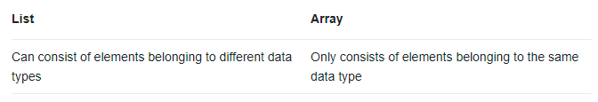
Difference: List and array
www.skillslash.com

Slide 5
Difference: List and Numpy array
Faster
Scalable
A numpy array is a grid of values, all of the same type, and is indexed by a tuple of nonnegative integers
A list is the Python equivalent of an array, but is resizeable and can contain elements of different types.
www.skillslash.com

Slide 6
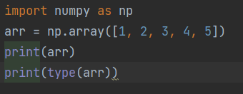
Creating and printing the array using numpy
www.skillslash.com

Slide 7
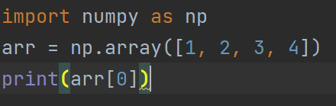
Indexing the array
www.skillslash.com

Slide 8
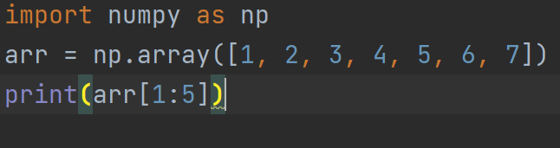
Slicing the array
www.skillslash.com

Slide 9
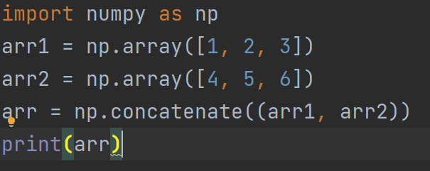
Basic operations- Join
www.skillslash.com

Slide 10
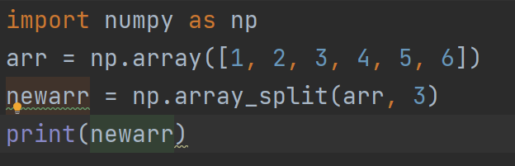
Basic operations- Split
www.skillslash.com

Slide 11
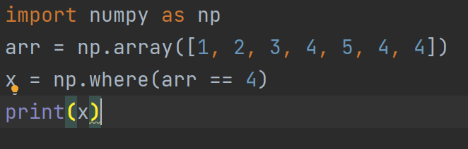
Basic operations- Search
www.skillslash.com

Slide 12
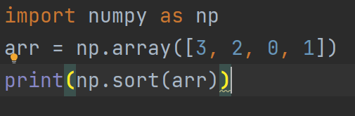
Basic operations- Sort
www.skillslash.com

Slide 13
Universal functions
Universal functions in Numpy are simple mathematical functions.
It is just a term that we gave to mathematical functions in the Numpy library.
Numpy provides various universal functions that cover a wide variety of operations.
www.skillslash.com

Slide 14
Universal functions - Trignometric
These functions work on radians, so angles need to be converted to radians by multiplying by pi/180. Only then we can call trigonometric functions. They take an array as input arguments. It includes functions like-
www.skillslash.com

Slide 15
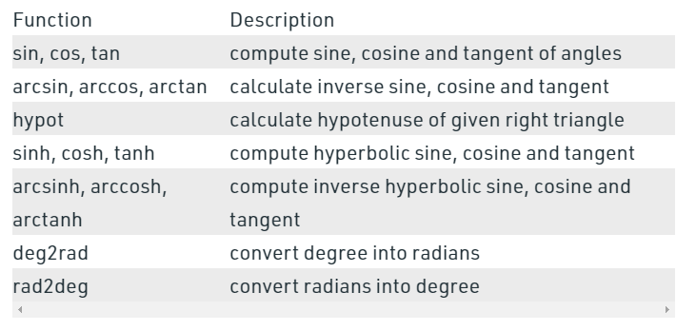
Universal functions - Trignometric
www.skillslash.com

Slide 16
Universal functions –Statistical
These functions are used to calculate mean, median, variance, minimum of array elements.
www.skillslash.com

Slide 17
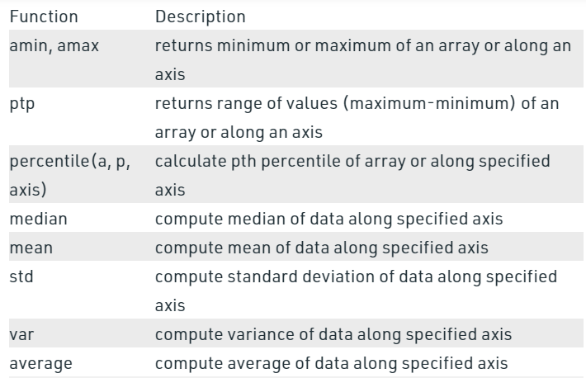
Universal functions –Statistical
These functions are used to calculate mean, median, variance, minimum of array elements.
www.skillslash.com

Slide 18
Universal functions –Bit-twiddling
These functions accept integer values as input arguments and perform bitwise operations on binary representations of those integers. It include functions like-
www.skillslash.com

Slide 19
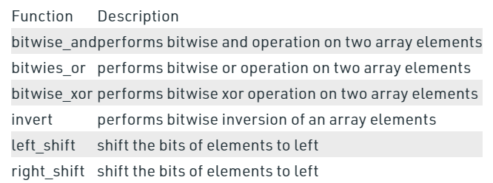
Universal functions –Statistical
www.skillslash.com

Slide 20
Arrays with structured data
Numpy’s Structured Array is similar to Struct in C.
It is used for grouping data of different types and sizes.
Structure array uses data containers called fields.
Each data field can contain data of any type and size.
Array elements can be accessed with the help of dot notation.
www.skillslash.com

Slide 21
Arrays with structured data
All structs in array have same number of fields.
All structs have same fields names.
A data type object (an instance of numpy. dtype class) describes how the bytes in the fixed-size block of memory corresponding to an array item should be interpreted.
www.skillslash.com

Slide 22
# Python program to demonstrate # Structured array
import numpy as np
a = np.array([('Sana', 2, 21.0), ('Mansi', 7, 29.0)],
dtype=[('name', (np.str_, 10)), ('age', np.int32), ('weight', np.float64)])
# Sorting according to the name
b = np.sort(a, order='name')
print('Sorting according to the name', b)
# Sorting according to the age
b = np.sort(a, order='age')
print('\nSorting according to the age', b)
Notes:
Sorting according to the name [('Mansi', 7, 29.0) ('Sana', 2, 21.0)]
Sorting according to the age [('Sana', 2, 21.0) ('Mansi', 7, 29.0)]

Slide 23
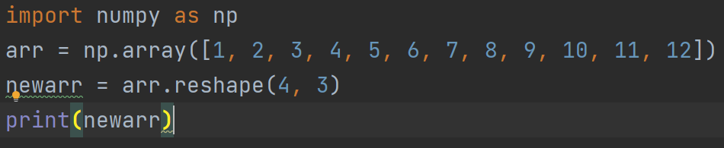
Changing shape in an array
www.skillslash.com
Notes:
import numpy as np arr = np.array([1, 2, 3, 4, 5, 6, 7, 8, 9, 10, 11, 12]) newarr = arr.reshape(4, 3) print(newarr)

Slide 24
Array broadcasting
The term broadcasting refers to the ability of NumPy to treat arrays of different shapes during arithmetic operations.
Arithmetic operations on arrays are usually done on corresponding elements.
If two arrays are of exactly the same shape, then these operations are smoothly performed.
www.skillslash.com

Slide 25
Array broadcasting
import numpy as np
a = np.array([1,2,3,4])
b = np.array([10,20,30,40])
c = a * b
print c
www.skillslash.com

Slide 26
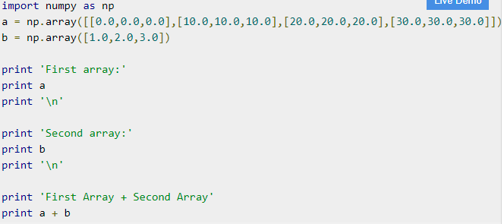

Slide 27
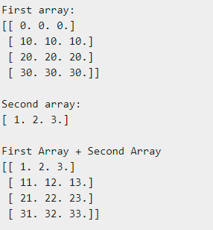

Slide 28
Vectorization
Numpy arrays are homogeneous in nature means it is an array that contains data of a single type only.
The concept of vectorized operations on NumPy allows the use of more optimal and pre-compiled functions and mathematical operations on NumPy array objects and data sequences.
The Output and Operations will speed-up when compared to simple non-vectorized operations.
www.skillslash.com

Slide 29
Using vectorized sum method on NumPy array. We will compare the vectorized sum method along with simple non-vectorized operation i.e the iterative method to calculate the sum of numbers from 0 – 14,999.

Slide 30
# importing the modules
import numpy as np
import timeit
# vectorized sum
print(np.sum(np.arange(15000)))
print("Time taken by vectorized sum : ", end = "")
%timeit np.sum(np.arange(15000))
# itersative sum
total = 0
for item in range(0, 15000):
total += item
a = total
print("\n" + str(a))
print("Time taken by iterative sum : ", end = "")
%timeit a

Slide 31
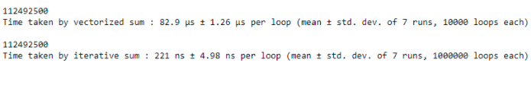

Slide 32
Conclusion
The above example shows the more optimal nature of vectorized operations of NumPy when compared with non-vectorized operations.
This means when computational efficiency is the key factor in a program and we should avoid using these simple operations, rather we should use NumPy vectorized functions.

Slide 33
Another Example
compare numpy exponential function with python built-in math library exponential function to calculate the exponential value of each entry in a particular object.

Slide 34
# importing the modules
import numpy as np
import timeit
import math
# vectorized operation
print("Time taken by vectorized operation : ", end = "")
%timeit np.exp(np.arange(150))
# non-vectorized operation
print("Time taken by non-vectorized operation : ", end = "")
%timeit [math.exp(item) for item in range(150)]

Slide 35
Output

Slide 36
Iterating over an array
Iterating means going through elements one by one.
As we deal with multi-dimensional arrays in numpy, we can do this using basic for loop of python.
If we iterate on a 1-D array it will go through each element one by one.
www.skillslash.com

Slide 37
Iterating over an array
import numpy as np
arr = np.array([1, 2, 3])
for x in arr:
print(x)
www.skillslash.com

Slide 38
Iterating over a 2d array
import numpy as np arr = np.array([[1, 2, 3], [4, 5, 6]]) for x in arr: print(x)
www.skillslash.com
Notes:
[1 2 3] [4 5 6]

Slide 39
Iterating over a 3d array
import numpy as np
arr = np.array([[[1, 2, 3], [4, 5, 6]], [[7, 8, 9], [10, 11, 12]]])
for x in arr:
print(x)
www.skillslash.com
Notes:
In a 3-D array it will go through all the 2-D arrays.
x represents the 2-D array:
[[1 2 3]
[4 5 6]]
x represents the 2-D array:
[[ 7 8 9]
[10 11 12]]

Slide 40
Splitting an array
Splitting is reverse operation of Joining.
Joining merges multiple arrays into one and Splitting breaks one array into multiple.
We use array_split() for splitting arrays, we pass it the array we want to split and the number of splits.
www.skillslash.com

Slide 41
Splitting an array
import numpy as np
arr = np.array([1, 2, 3, 4, 5, 6])
newarr = np.array_split(arr, 3)
print(newarr)
www.skillslash.com
Notes:
[array([1, 2]), array([3, 4]), array([5, 6])]

Slide 42
Splitting an array
If the array has less elements than required, it will adjust from the end accordingly.
import numpy as np
arr = np.array([1, 2, 3, 4, 5, 6])
newarr = np.array_split(arr, 4)
print(newarr)
www.skillslash.com

Slide 43
Split into array
The return value of the array_split() method is an array containing each of the split as an array.
If you split an array into 3 arrays, you can access them from the result just like any array element:

Slide 44
Split into array
import numpy as np
arr = np.array([1, 2, 3, 4, 5, 6])
newarr = np.array_split(arr, 3)
print(newarr[0])
print(newarr[1])
print(newarr[2])

Slide 45
Splitting 2-D Arrays
Use the same syntax when splitting 2-D arrays.
Use the array_split() method, pass in the array you want to split and the number of splits you want to do.

Slide 46
Splitting 2-D Arrays
import numpy as np
arr = np.array([[1, 2], [3, 4], [5, 6], [7, 8], [9, 10], [11, 12]])
newarr = np.array_split(arr, 3)
print(newarr)

Slide 47
Miscellaneous Functions and Methods
https://numpy.org/doc/stable/reference/routines.math.html
www.skillslash.com

Slide 48
Copy vs View
Copy is a new array that is created
Copy is physically stored in another location.
The copy owns the data and any changes made to the copy will not affect original array, and any changes made to the original array will not affect the copy.
View is the view of the original array
View has same memory location as the original array
The view does not own the data and any changes made to the view will affect the original array, and any changes made to the original array will affect the view.
www.skillslash.com

Slide 49
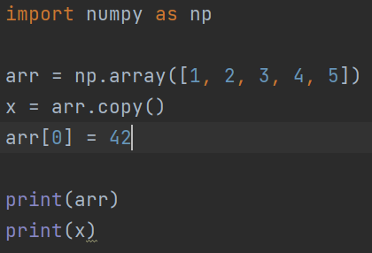

Copy()

Slide 50
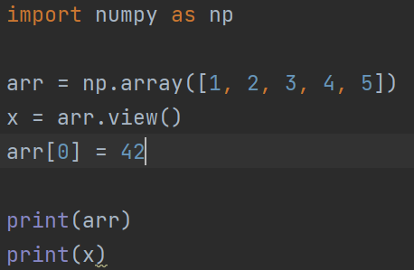

View()

Slide 51
Vector Stacking
numpy.stack() function is used to join a sequence of same dimension arrays along a new axis.
The axis parameter specifies the index of the new axis in the dimensions of the result.
For example, if axis=0 it will be the first dimension and if axis=-1 it will be the last dimension.
www.skillslash.com

Slide 52
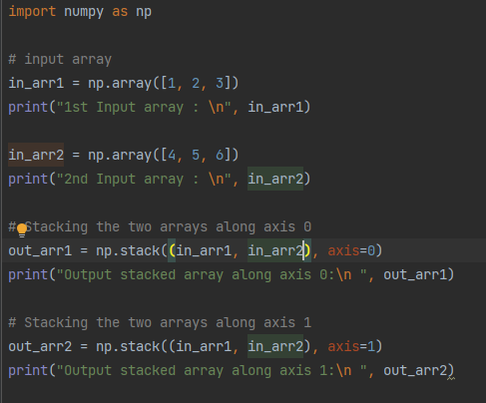
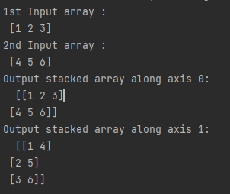

Slide 53
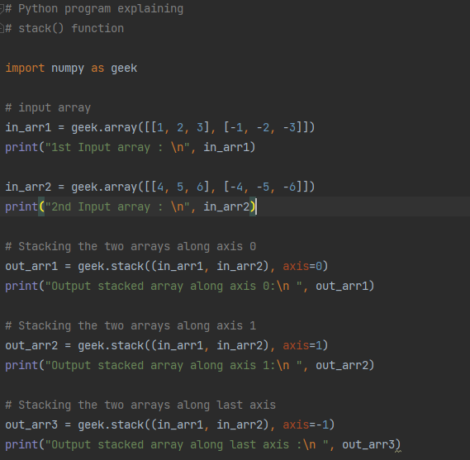
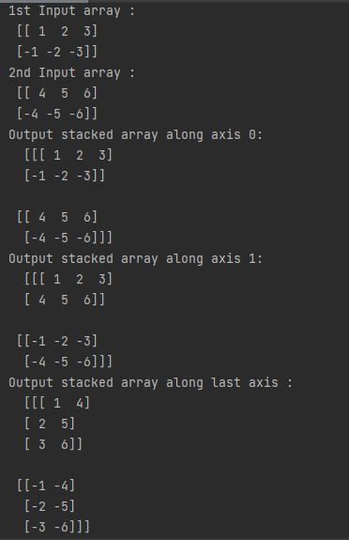

Slide 54
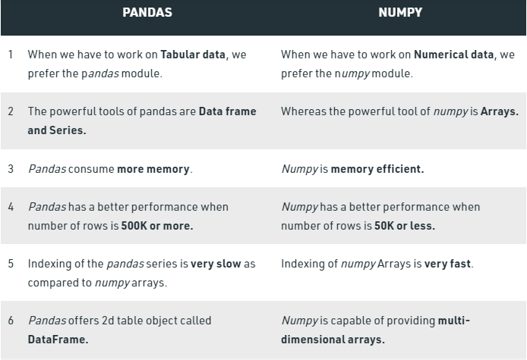
Numpy and Pandas

Slide 55
Numpy and Scipy
SciPy, a scientific library for Python is an open source
The SciPy library depends on NumPy, which provides convenient and fast N-dimensional array manipulation
The main reason for building the SciPy library is that, it should work with NumPy arrays
It provides many user-friendly and efficient numerical practices such as routines for numerical integration and optimization

Slide 56
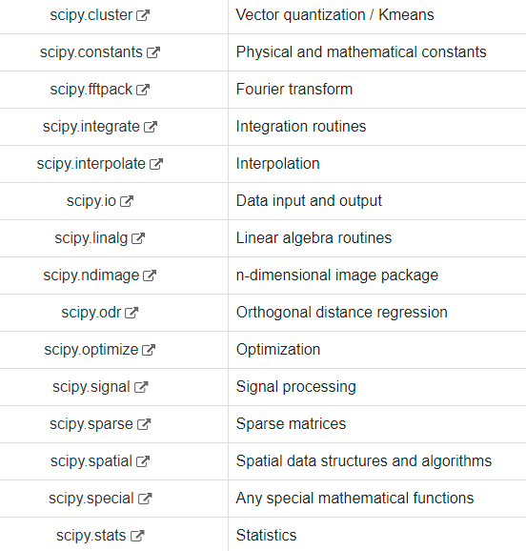
SciPy packages

Slide 57
https://scikit-image.org/
(Will be taken in image processing)
Scikit image library
Gallery>Data
Few images
Astronaut class has code in form of the image

Slide 58
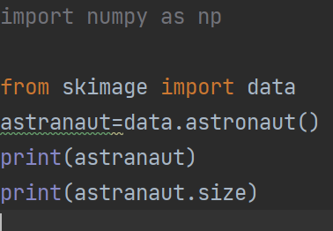
Notes:
import numpy as np from skimage import data astranaut=data.astronaut() print(astranaut) print(astranaut.size)

Slide 59
THANK YOU
www.skillslash.com

